Slide 1
CSE4019 - Image Processing
J component Final Review
Faculty: Dr. Geetha S
Slot: E1 + TE1

Slide 2
Wild Animal Detection using Computer Vision
Team Members:
Sahil Faizal - 19BPS1083
Sanjay Sundaresan - 19BPS1113

Slide 3
Introduction
The expansion of urban areas in modern times has resulted in widespread displacement of habitats in forested areas. As a result, wild animals are forced to venture into the human settlements that often infringe on their routine activities.
More often than not, food is the primary motivator for such peregrinations. It is at this point that there is tangible danger to any humans that inadvertently cross the path of these animals when they are at their most ferocious predispositions.
Hence, a need arises for the detection of wild animals at the border of human settlements close to wild habitats. A robust, reliable and effective preemptive warning mechanism would drastically eliminate risk of fatal human-animal conflict, both in the interest of protecting human lives and avoiding loss of endangered animals.
Moreover, such a system would also be useful in wildlife sanctuaries and biosphere reserves to monitor the movement of animals at the border areas of such establishments which have often proved difficult to control.

Slide 4
Literature Review
http://www.aui.ma/sse-capstone-repository/pdf/spring-2019/DETECTING_ANIMALS_USING_COMPUTER_VISION.pdf - This paper deals with the detection of non-camoflagued animals from still images using image segmentation by K-Means algorithm, and removing the ensuing noise in order to achieve clear segmentation that ultimately leads to better classifier performance, regardless of the classifier chosen.
https://www.ripublication.com/ijcir17/ijcirv13n9_07.pdf - This paper proposes an algorithm named WCoHOG (Weighted Co-occurrence Histograms of Oriented Gradients), which essentially uses gradient direction and magnitude to extract more robust feature vectors, which are then fed to the classifier.
http://troindia.in/journal/ijcesr/vol6iss5/28-37.pdf - This paper focuses on background subtraction (for object detection), and feature extraction as major processing steps before classification. It uses Laplacian of Gaussian operation to find corners and edges, which in turn help in finding keypoints and perform feature extraction. SVM classifier is used on the extracted features.
Notes:
Paper 2 - Sliding window technique

Slide 5
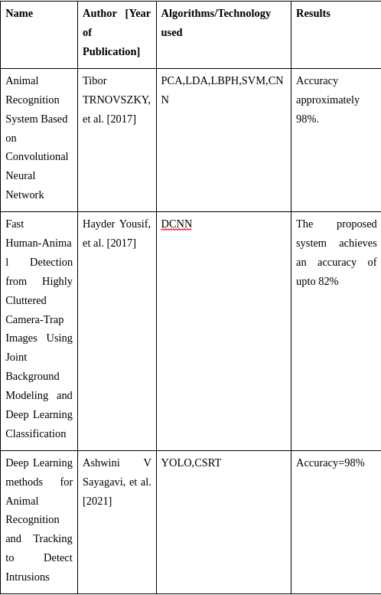
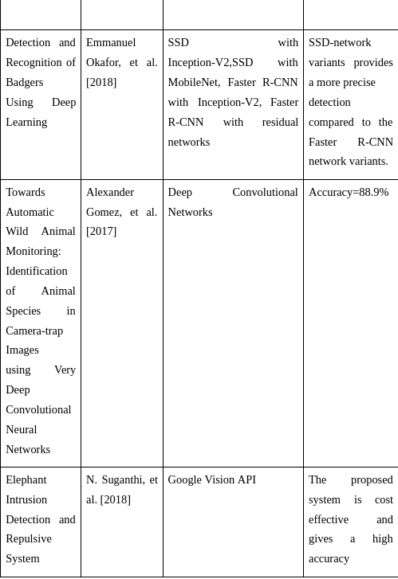
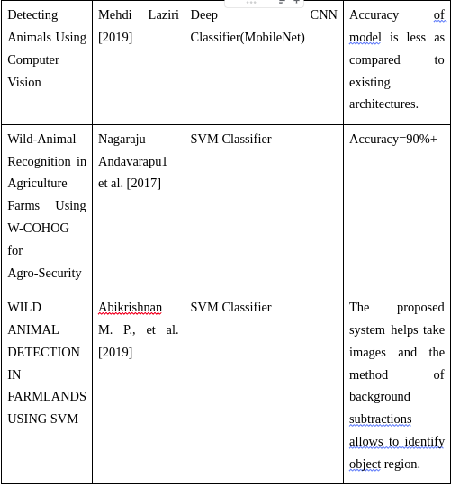

Slide 6
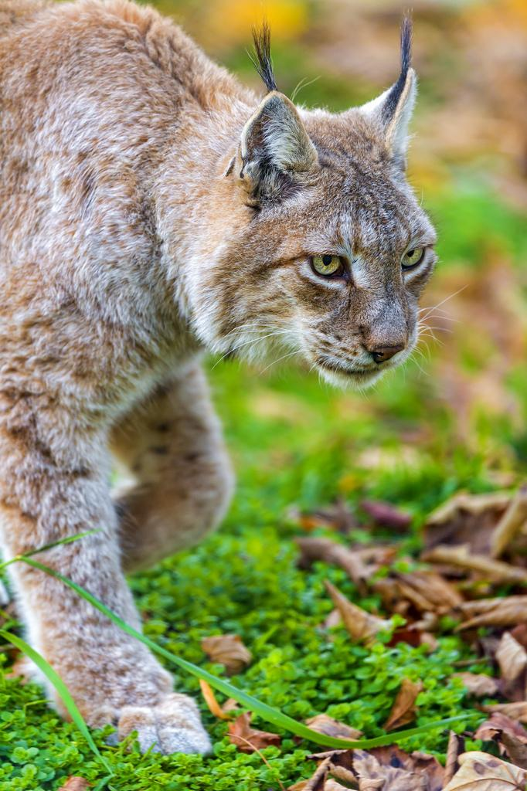
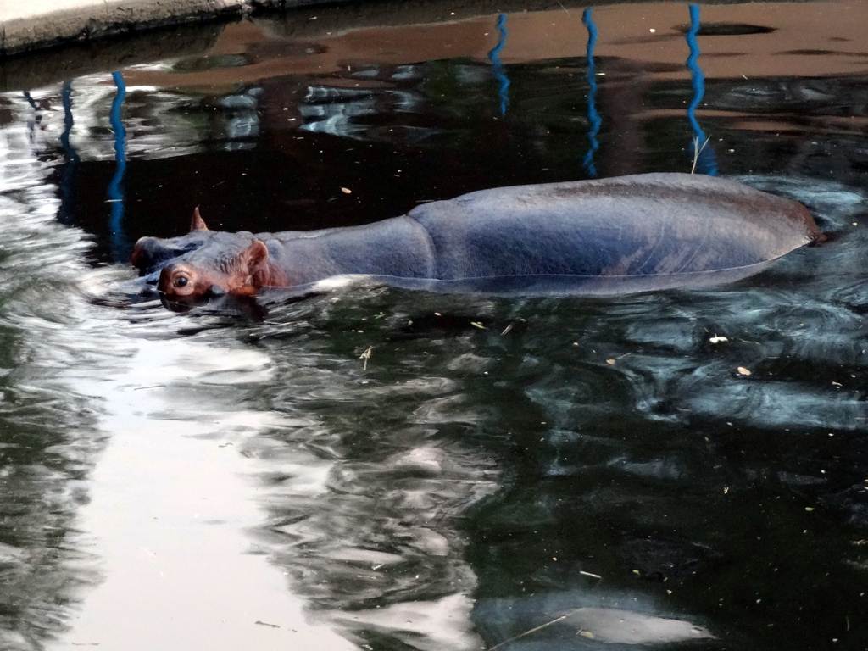
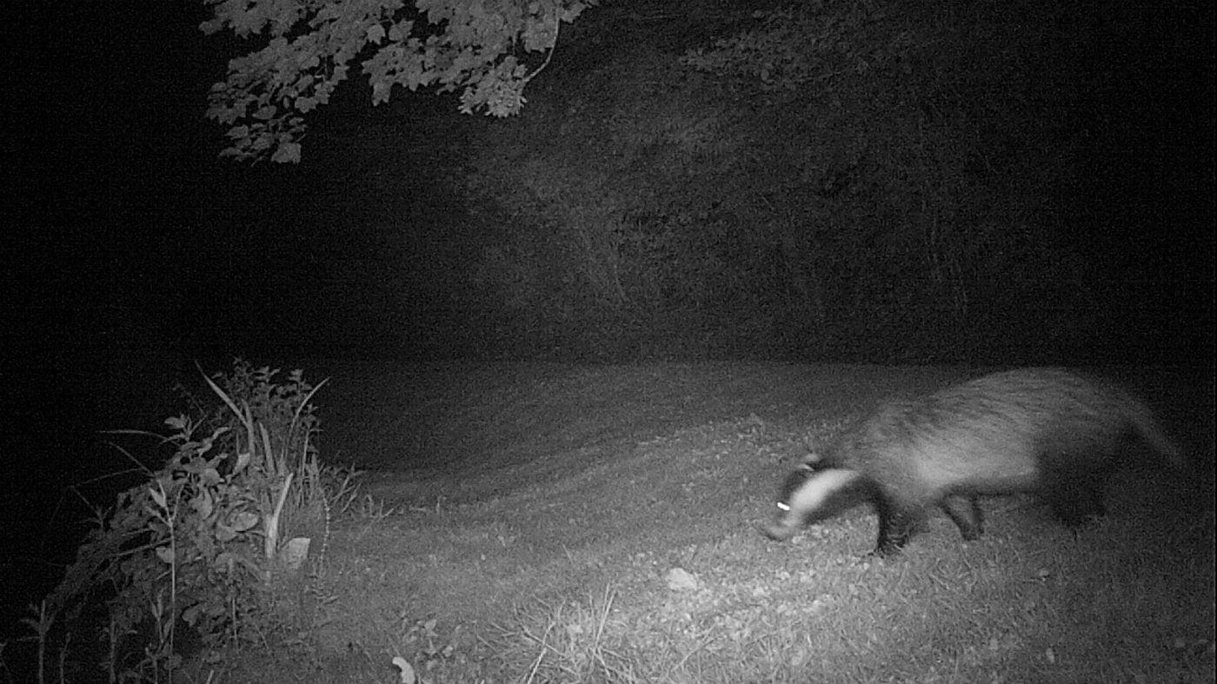
Input
Images captured from the camera trap.

Slide 7
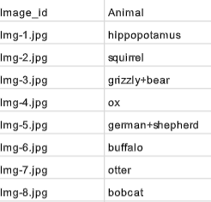
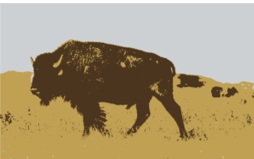
Expected Output
Processed Images, which are fed to the classifier that ultimately identifies the class of the animal. (Below - Representational Images)

Slide 8
Challenges
Blurring out of images due to zooming issues
Light intensity affecting the recognition because of darkness.
Background of the captured images leading to wrong prediction.
Limited number of animals covered.
Luminance problem because of shadowing.

Slide 9
Approach
The classifier needs to extract features from the images in order to assign a class to them, thus the preprocessing was done specifically to ensure that the features were as distinctly visible as possible.
First, K-Means based segmentation was done via openCV. A K-Value of 3 was used, essentially ensuring that every input image had 3 major regions which were distinct.
There was a fair amount of noise in the images, which was also handled when the segmentation was being performed. .
The processed images were then fed to the CNN-based classifier which predicts the class of the animal. For this purpose the technique of fine-tuning was used in which the convolutional layers of pre-trained neural network are used as it is and the fully connected layers are built keeping the entire model open for training and updation of weights.

Slide 10
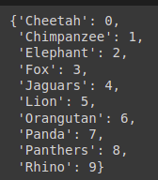
Novelty
K-Means Image Segmentation
Data Augmentation
Classifier with 10 classes of wild animals
Diverse Dataset of over 6500 images
Absence of Class Imbalance with Artificial Synthesis of Images
Fine Tuning Technique to Maximise Accuracy

Slide 11
Classifier used: InceptionResNetV2
It is a Convolutional Neural Network that is trained on more than a million images from the ImageNet Database.
The network is 164 layers deep and can classify upto 1000 categories.
As a result the model has rich experience of feature extraction from images.
Input image size is 299 * 299
Commonly used along with the method of Transfer Learning.
Efficient in Image Classification use cases with minimal loss

Slide 12
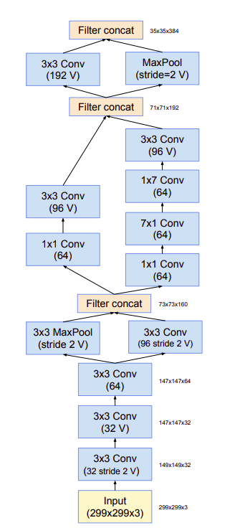
Model Architecture

Slide 13
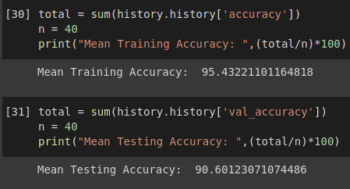
Results
During the experimentation process various models have been developed including EfficientNet, InceptionV3, MobileNetV3, VGG19 etc. But they failed to produce better results compared to InceptionResNetV2.
The model achieved an average training accuracy of 95% and testing accuracy of 91%.
The analysis of the performance plots of the classier can give a better understanding.
Improved quality and diversity of images in the dataset can further increase the accuracy of the model.
The techniques used in this project has been effective enough to remove much of the background noise and distortions from the original dataset.
The model has been trained for 20 epochs and the training time is around 2 hrs with GPU.

Slide 14
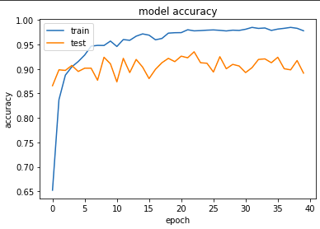
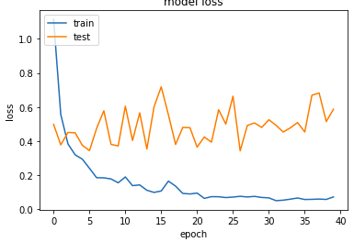
Performance Plots

Slide 15
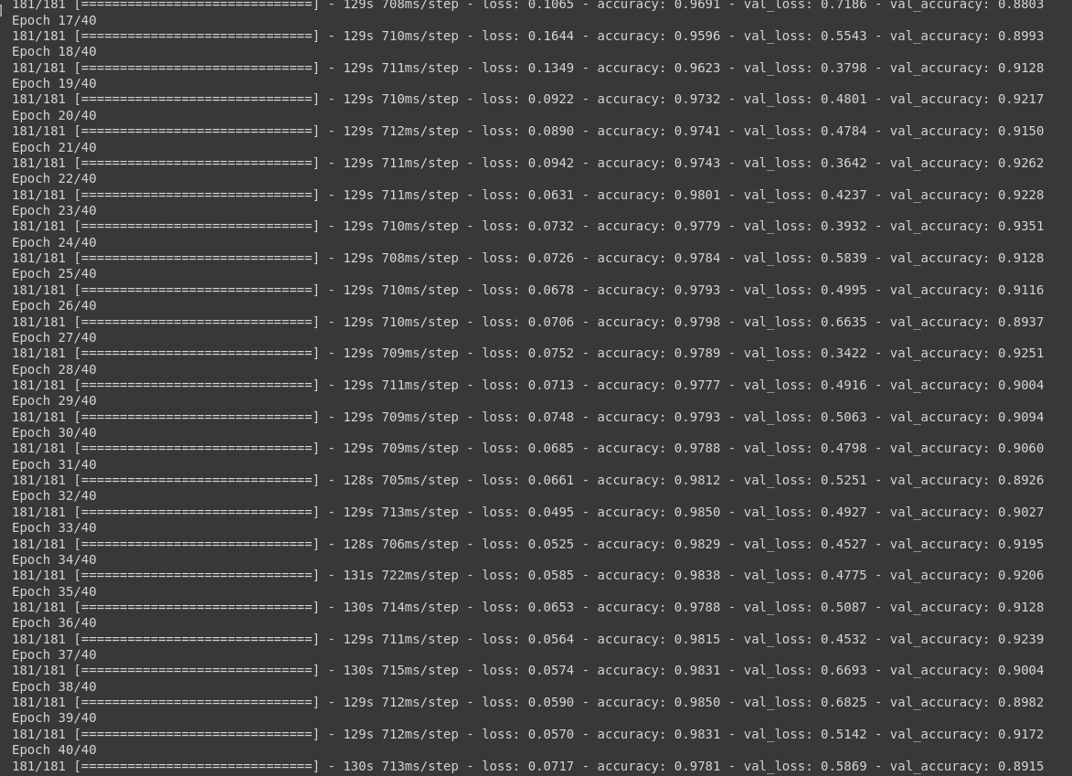
Training Phase

Slide 16
Conclusions and Inferences
Segmentation and feature detection play a major role in the accuracy of the classifier. The usage of 3 main regions in the images boosts the performance further towards an optimal value.
The usage of a larger number of regions was not feasible due to the noise that was generated in the processed image.
The importance of image processing techniques before and during the preliminary stages of classification and model building is clearly highlighted by the results.
The accuracy of the model makes it suitable for linkage with real-time wildlife camera feeds. Further, the image processing performed on the input images is crucial to handle the heterogeneity introduced by the image sources.

Slide 17
https://colab.research.google.com/drive/1S2cGnsypjUmEak5shhIp6d6O391Q8lV2?usp=sharing
Link to Notebook

